Slide 1
Weak Lensing
Tom Kitching (WL SWG coordinator)
_{Henk Hoekstra, Karim Benabed}

Slide 2
A Review of Weak Lensing
Theory
Why do we measure?
From General Relativity
Measurement
What do we measure?
Cosmology
How do we extract cosmological information?

Slide 3
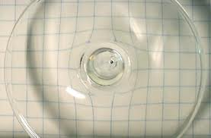
Gravitational Lensing
You can tell what a lens is made of by the distortion it creates

Slide 4
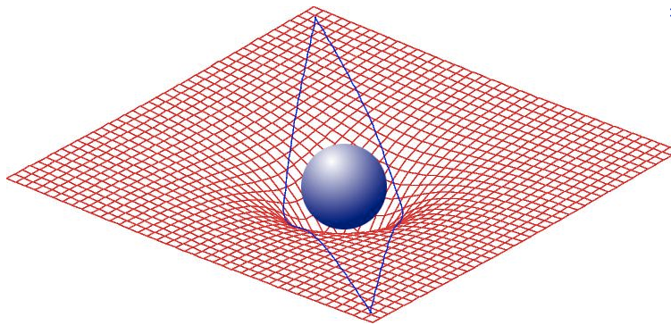
Gravitational Lensing
Einstein: Mass bends spacetime, and distorts the path that light rays take
Analogous to an optical lens
Depends ONLY on the geometry of the lens-observer-source

Slide 5
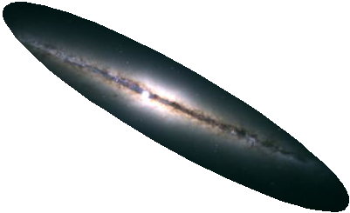
Gravitational Lensing
Einstein: Mass bends spacetime, and distorts the path that light rays take

Slide 6
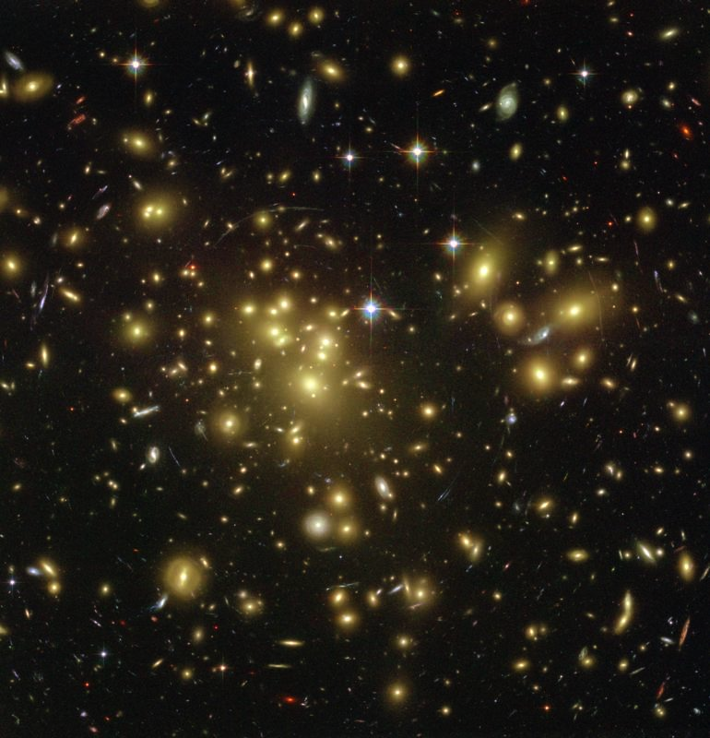
Kappa > 1
Strong Lensing
Multiple Images
See Massimo Meneghetti’s Presentation
z
© NASA

Slide 7
‘Weak’ Lensing
Every galaxy experiences some lensing
Caused by matter along the line of sight

Slide 8
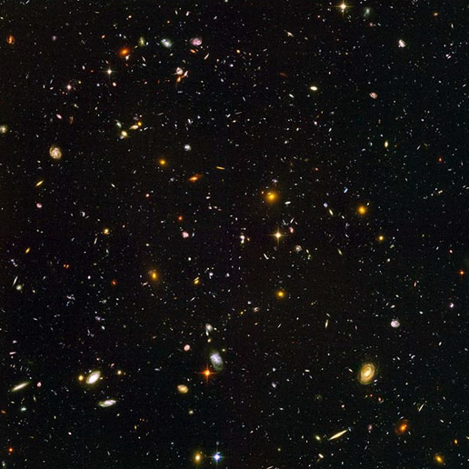
Kappa<< 1
Weak Lensing
Local Distortion
z
© NASA

Slide 9
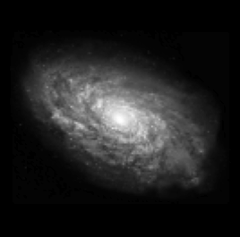
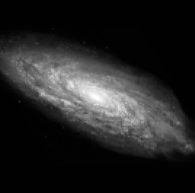
The weak distortion is simply a (very small) change in ellipticity of a galaxy
Dark Matter

Slide 10

The weak distortion is simply a change in ellipticity of a galaxy
Slide from R Massey

Slide 11
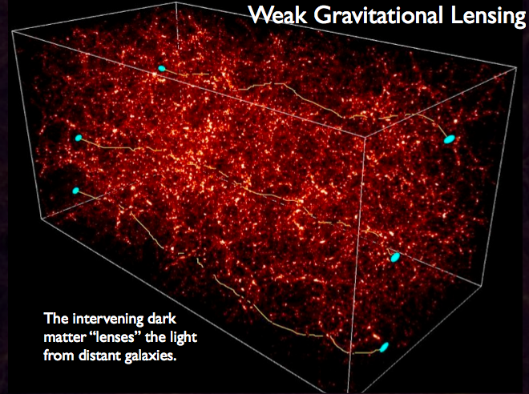
Large Scale Structure

Slide 12
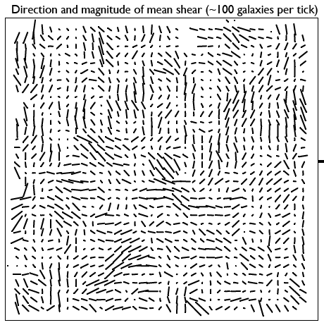

Slide 13
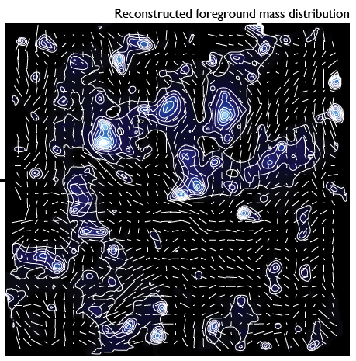
Slide from COSMOS survey

Slide 14
Same but with more technical details

Slide 15
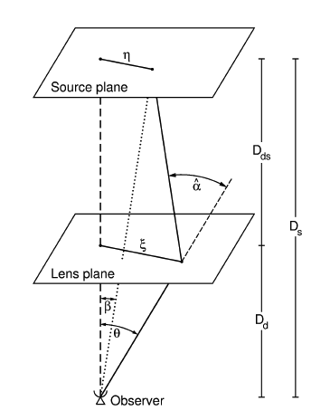
What is Gravitational Lensing?
Propagating photons follow geodesics in space
The geodesics are distorted from ‘straight’ lines by the presence of massive objects
Even in Newtonian Gravity photons would be deflected from straight line path
Figure from Bartelmann & Schneider 2003
Notes:
Basic idea behind gravitational lensing

Slide 16
Geometry
The Born Approximation
Notes:
The geometry of lensing

Slide 17
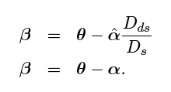
The Lens Equation
Ratio of angular diameter distances
Simple Geometry
Relates True Position β
to Observed Position ϑ
Notes:
An expression of that geometry

Slide 18
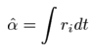
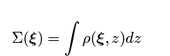
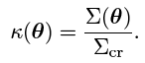
Relates True Position to
Observed Position
Thin Sheet Born Approximation :
Kappa > 1 =
Strong Lensing
Kappa << 1 =
Weak Lensing

Slide 19
Deflection Angle from GR
Want to know what the integrated deflection angle is
Next slides has a lot of maths…. So will quickly skip over it!

Slide 20
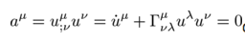
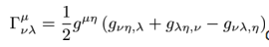
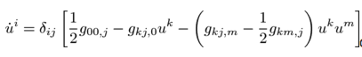
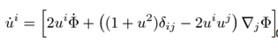
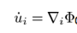
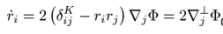
From GR
Metric in the Weak Field Limit
Newtonian Potential
GR Equation of Motion
Γ related to metric g
Set time-changes in metric to be small g_{i0}=0. Spatial Part:
Substitute metric :
Newtonian Limit u_{i}<<c :
Relativistic Limit u_{i}~r_{i}c :

Slide 21
Take home message
The amount of deflection depends on the spatial derivative of the local gravitational potential
Can also use Fermats principle of least time
With refractive index of lens n=1-2ϕ/c²

Slide 22
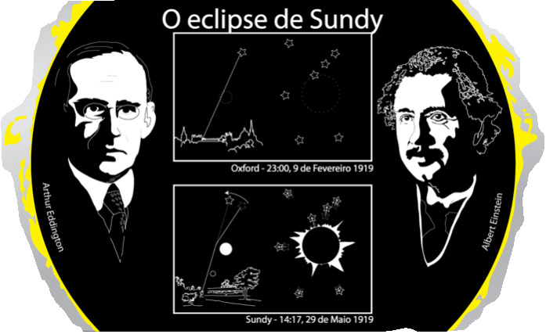
GR-Newton Factor of 2 Confirmed in 1919
Euclid launches (hopefully!) 100 years later!
© R. Massey 2010

Slide 23
Kappa<< 1
Weak Lensing
Local Distortion
z
© NASA

Slide 24
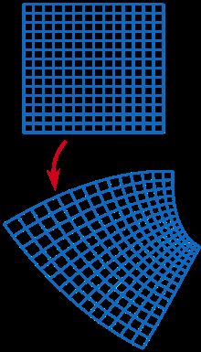
The Distortion Matrix
Go back to the lens equation
Every point is mapped to a new point via a shear mapping
Wikipedia

Slide 25
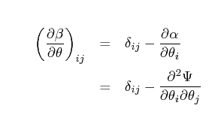
The Distortion Matrix
Define a lensing potential ψ
Projected Newtonian potential - Born approximation (linear transform)
Derivative of the lens equation (Jacobian)
Describes how unlensed point maps to lensed point
ψ=0 implies no mass and no lensing

Slide 26
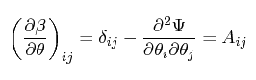
The Distortion Matrix
Define the Distortion Matrix (Jacobian) as
Second derivatives of the lensing potential
ψ₁₁, ψ₂₂, ψ₂₁, ψ₁₂
Jacobian gives one derivative, GR the other

Slide 27
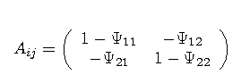
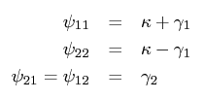
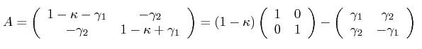
Shear and Convergence
Closer look at the Distortion matrix
Decompose into a trace and traceless part
Define

Slide 28
Shear and Covergence
What shape of distortion does this imply?

Slide 29
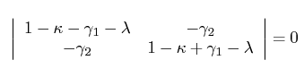
Disortion is Elliptical
For a general set of source positions X write the eigen equation
AX=λX
(A-λ)X=0
Characteristic equation : |A-λ1|=0
λ are the eigenvalues

Slide 30
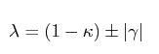
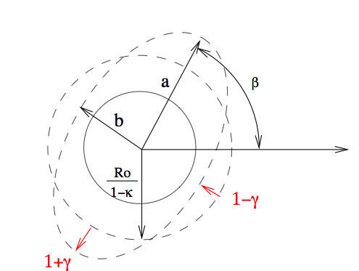
Distortion is Elliptical
Solving the determinant
γ₁
γ₂

Slide 31
Distortion is elliptical
Size change
Ellipticity change
γ₁
γ₂

Slide 32
Recap
Lensing equation
Local conformal mapping
General Relativity relates this to the gravitational potential
Distortion matrix implies that distortion is elliptical : shear and convergence
Simple formalise that relates the shear and convergence (observable) to the underlying gravitational potential

Slide 33
Measurement

Slide 34
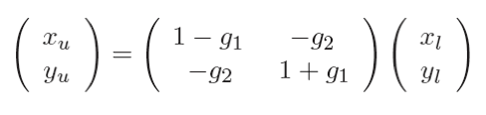
Cosmic Lensing
g_{i}~0.2
Real data:
g_{i}~0.03
34/19
Notes:
34

Slide 35
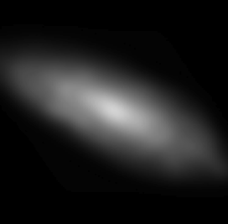
Atmosphere and Telescope
Convolution with kernel
Real data: Kernel size ~ Galaxy size
35/19
Notes:
35

Slide 36
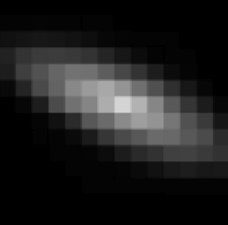
Pixelisation
Sum light in each square
Real data: Pixel size ~ Kernel size /2
36/19
Notes:
36

Slide 37
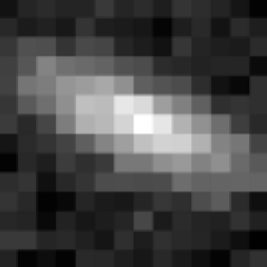
Noise
Mostly Poisson. Some Gaussian and bad pixels.
Uncertainty on total light ~ 5 per cent
37/19
Notes:
37

Slide 38
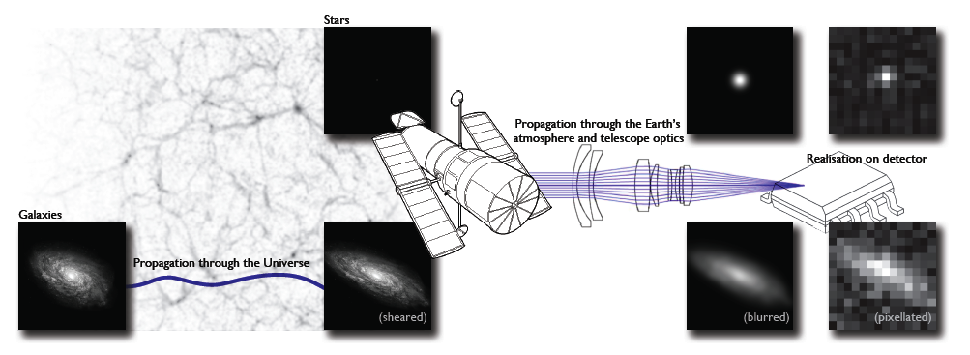
Figure from Kitching et al. 2012
Need to measure shear to 10⁻³
Large Scale Structure imprints an ADDITIONAL ELLIPTICTY called SHEAR

Slide 39
How do we measure ellipticity and shear ?
Two widely used methods
Measure quadrupole moments of the pixels
Fit galaxy models to the data, in part parameterised by ellipticity

Slide 40
What is ellipticity
Specified by 3 numbers
Semi-Major axis
Semi-Minor
Angle
Many different
equations for an ellipse use
different parameterizations
and coordinate systems
a=Semi-Major Axis
ϑ
b=Semi-Minor Axis
Best to think of an ellipse as a compression/stretching of
the axes, followed by a rotation

Slide 41
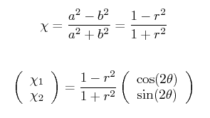
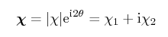
X₁
X₂
Create a single (complex) number “ellipticity”
Include orientation
r=1 means?
Why 2, what does this mean?

Slide 42
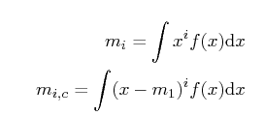
How to measure ellipticity?
Consider moments of a 1D distribution
0th Moment = ?
1st Moment = ?
2nd Moment = ?

Slide 43
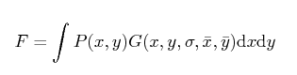
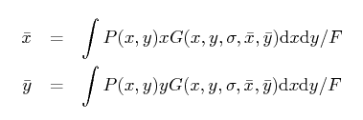
Moments of a 2D Function
Include a weight G
0th Moment (flux)
1st Moments
Mean x
Mean y

Slide 44
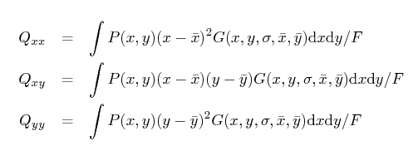
2nd Order Moments in 2D
Three 2nd order moments
Recall that ellipticity needs 3 numbers so we suspect they are related

Slide 45
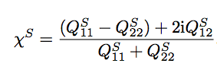
Science Requirements
are derived from the impact of
Instrumental and astrophysical
Effects on the quadrupole moments

Slide 46
Cosmology

Slide 47
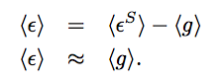
The Weak Lensing Assumption
When we average over (enough) galaxies in the universe the intrinsic ellipticity is randomly orientated such that
This is an approximate expression
KEY WEAK LENSING RESULT
RELATES
OBSERVABLE (MOMENTS) to
PHYSICS (LENS EQUATION) and SHEAR

Slide 48
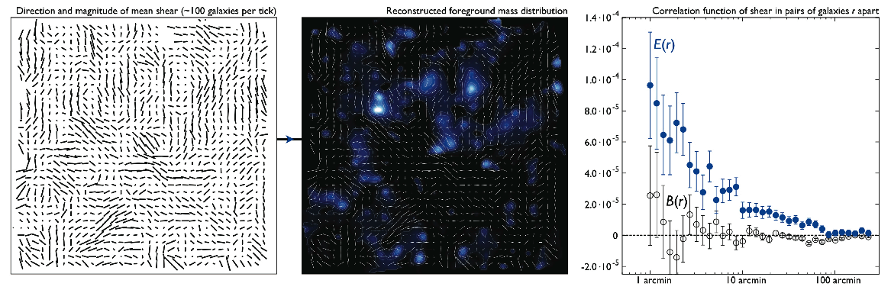
When averaged over sufficient area the shear field has a mean of zero
Use 2 point correlation function or power spectra which contains cosmological information

Slide 49
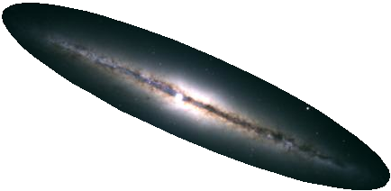
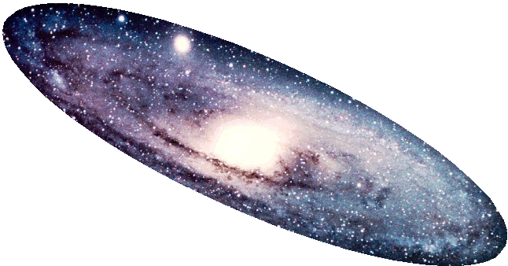
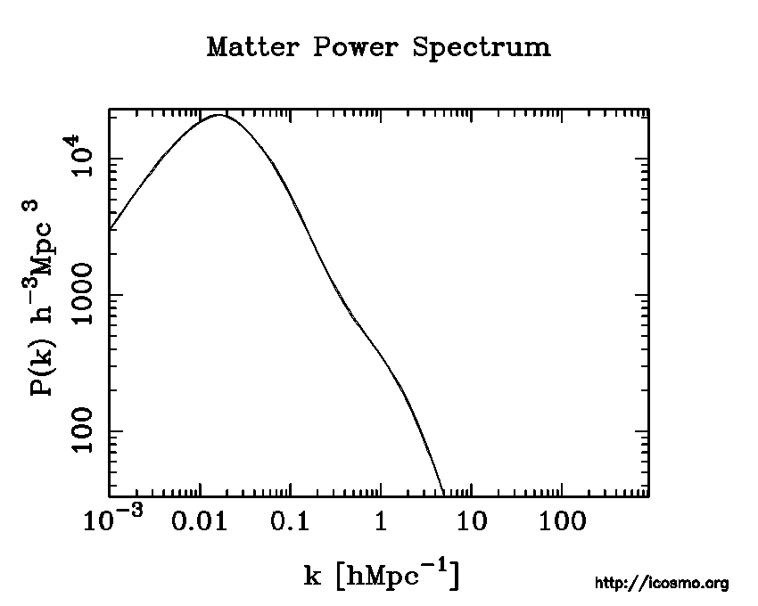
What can we observe?
Wavelengths
Angles
θ
z
z

Slide 50
Are points clustered on a particular scale?
Throw down sticks, what is the probability that two
Galaxies are at the end of the sticks compared to random case
Is there an excess of clustering
Like a 2D version of variance

Slide 51
Are points clustered on a particular pair of scales?
Is there an excess clustering of clusters
Like a 2D version of skewness/kurtosis

Slide 52
What can we observe?
Shapes
z
Information on
Matter power spectrum
Angular Diameter Distance

Slide 53
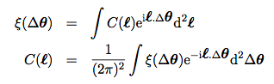
Correlation function measures the tendency for galaxies at a chosen separation to have preferred shape alignment

Slide 54
Is there an excess of shape alignment

Slide 55
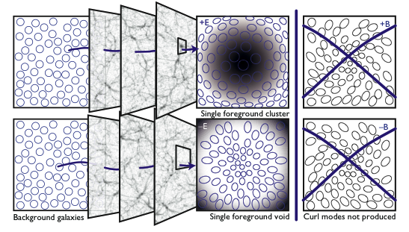

Slide 56
Correlation function measures the tendency for galaxies at a chosen separation to have pre- ferred shape alignment

Slide 57


Geometry
Large Scale Structure
Light paths integrated
Over source to observer

Slide 58
Dark Energy, Modified Gravity, Neutrino Physics

Slide 59
Slide from H Hoekstra

Slide 60
Current State-of-Art
CFHTLenS survey
Ground-based survey
154 square degrees to median z=0.8
See Kitching et al. 2012, Kilbinger et al. 2012, Simpson et al. 2012, Benjamin et al. 2012 for cosmological results

Slide 61

Current Galaxy Clustering
Current Weak Lensing
Current WL + GC
All Combined
Change in Time Dilation
Change in Spatial Curvature
Simpson et al. 2012

Slide 62
A Review of Weak Lensing
Theory
Why do we measure?
From General Relativity
Measurement
What do we measure?
Cosmology
How do we extract cosmological information?

